Slide 1

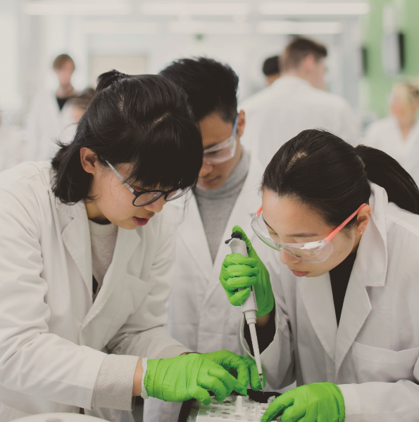
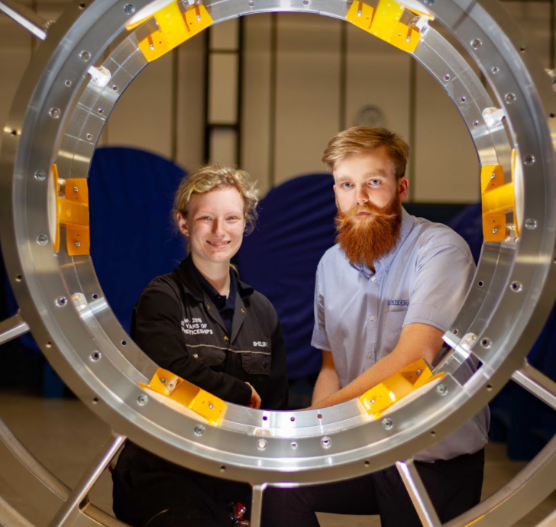
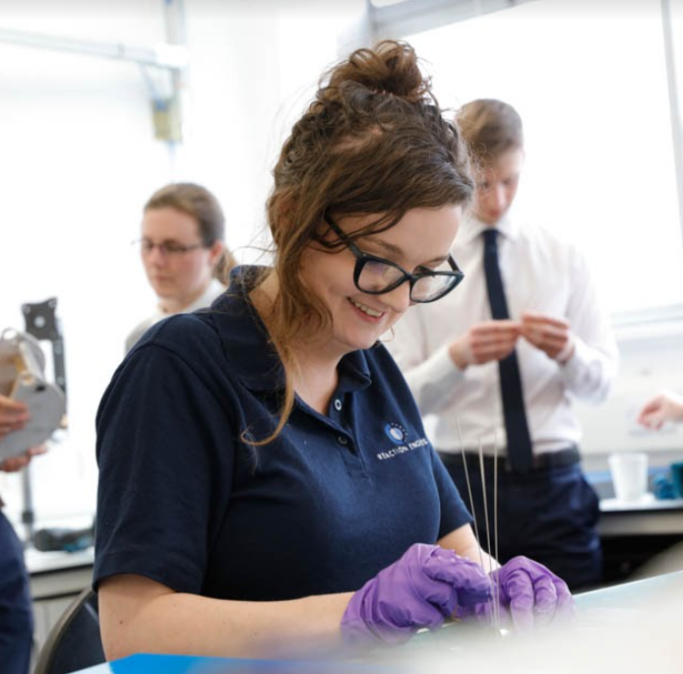
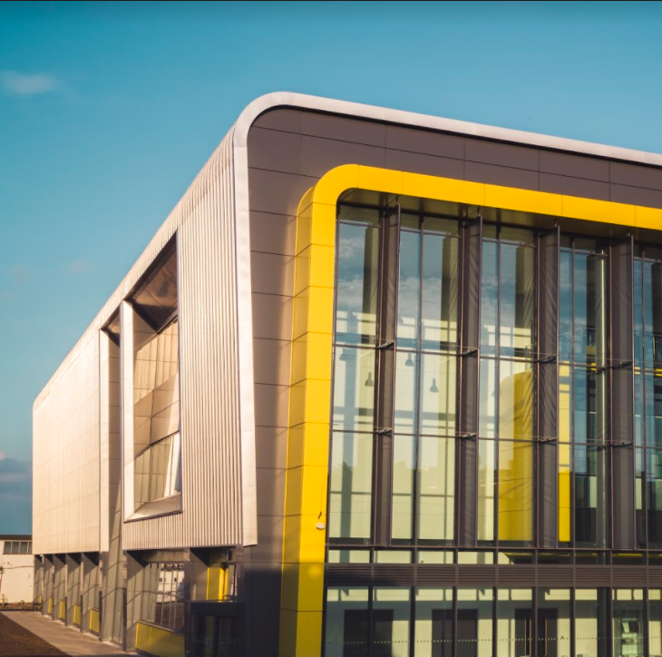
Oxford-Cambridge
Arc
MKBLP
02 December 2020

Slide 2
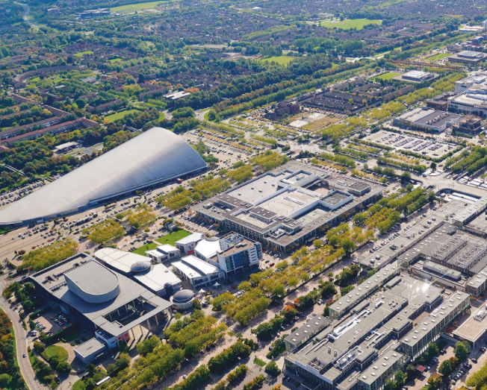
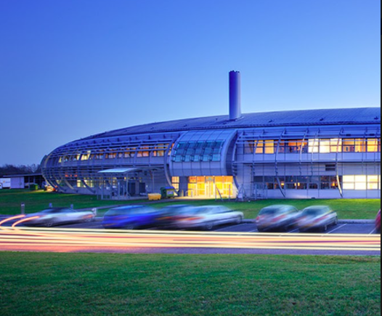
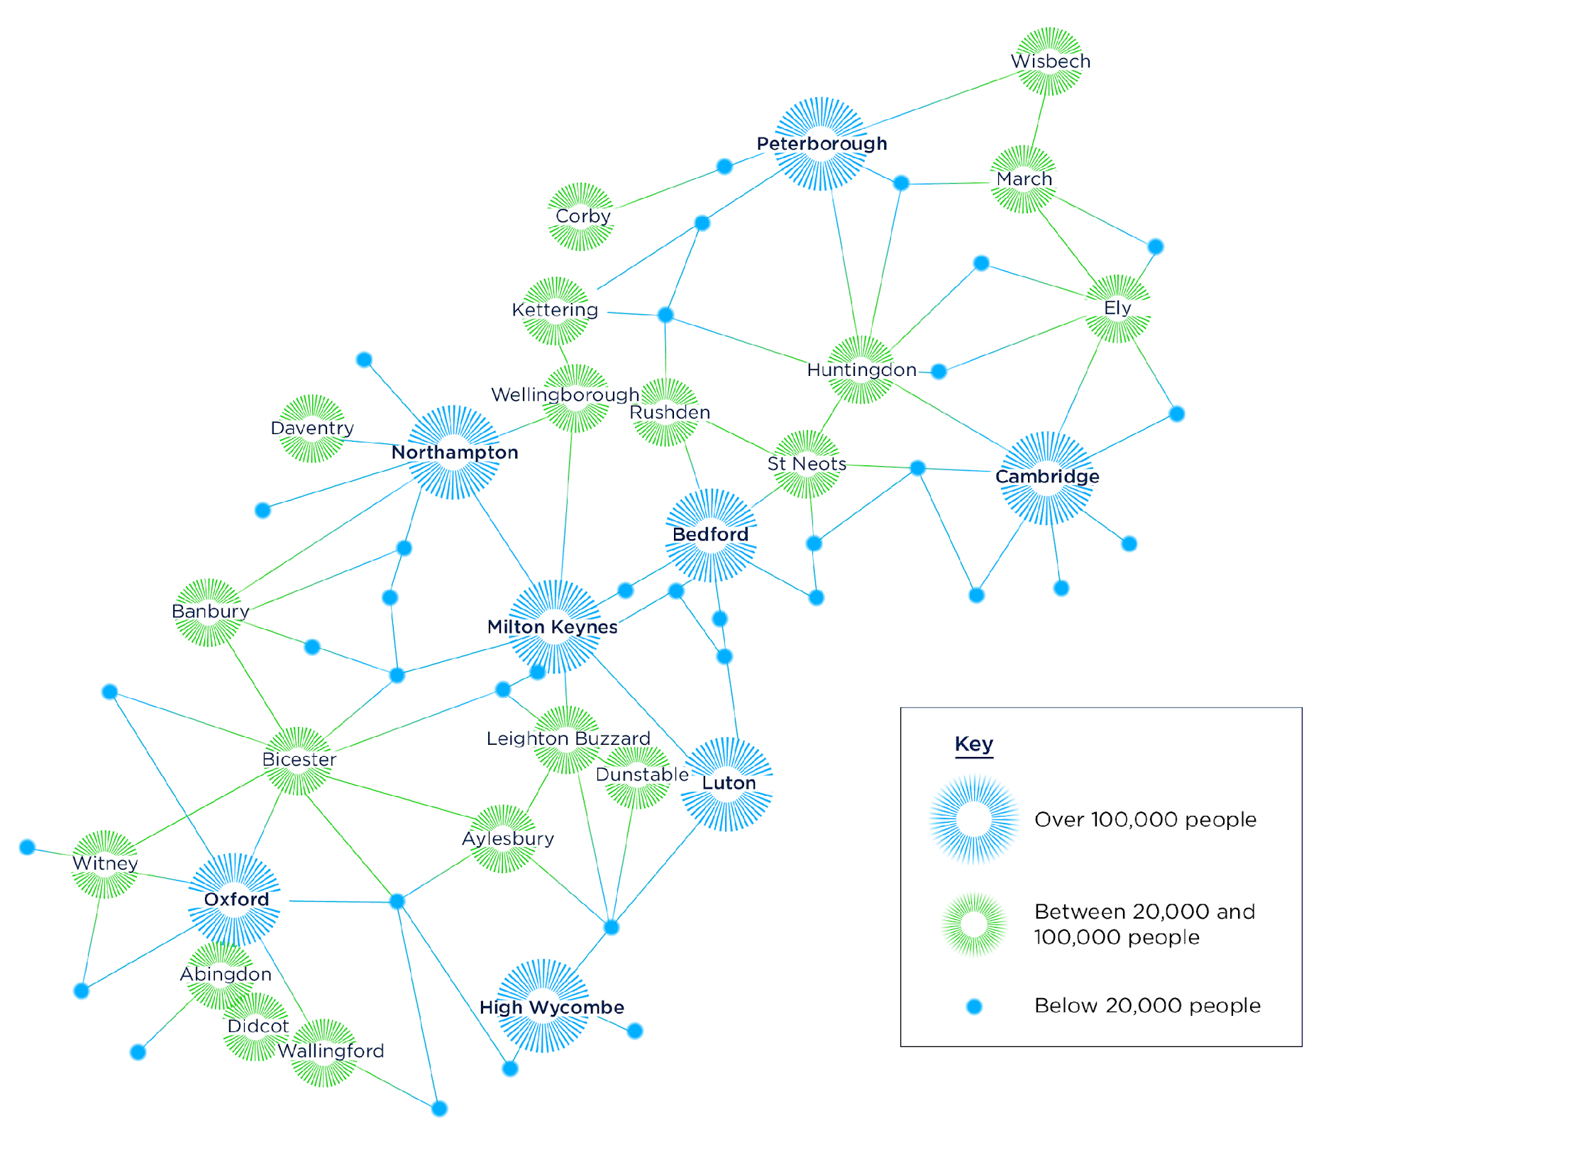

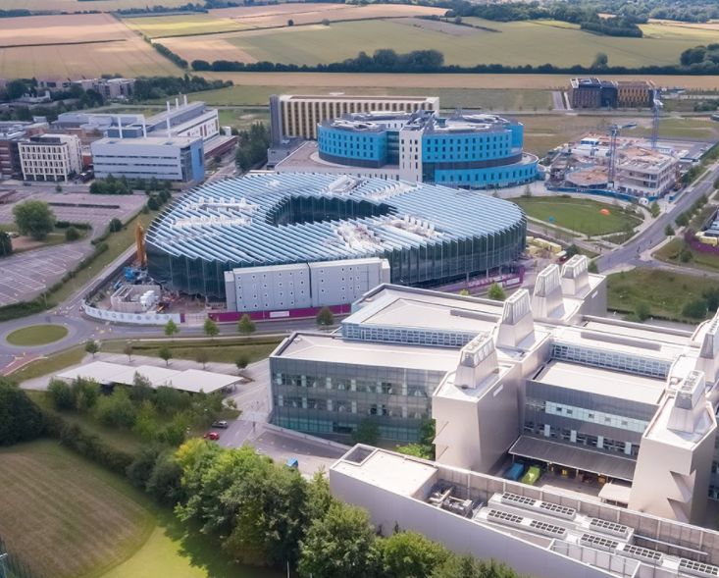
Oxford-Cambridge
Arc
A network of successful, fast-growing & productive places, each with distinct potential, underlying specialisms, cultural attractions and heritage.
3.8 million residents
Current GVA p.a. of £111bn
2 million jobs
10 universities, contributing £13bn p.a. GVA
At centre of UK transport and logistics network, with easy connectivity to London, regional centres and an international gateway.

Slide 3
Arc leadership groups
Arc Leadership Plenary
All Member Growth Boards
All Member Local Authorities
All Member Local Enterprise Partnerships
All Member Arc Universities Group (AUG)
Government Arc Ministries
Relevant Agencies, Health Bodies
Government
Arc Team
Arc Leadership Executive
(Growth Board Leader Representatives, AUG Chair, Enterprise Partnerships Chair, Health Bodies Chair)
Arc Chief Executives Group
Local Authorities
Local Enterprise Partnerships
Arc Universities Group
Productivity
Connectivity
Environment
Place
Oxford-Cambridge Arc

Slide 4
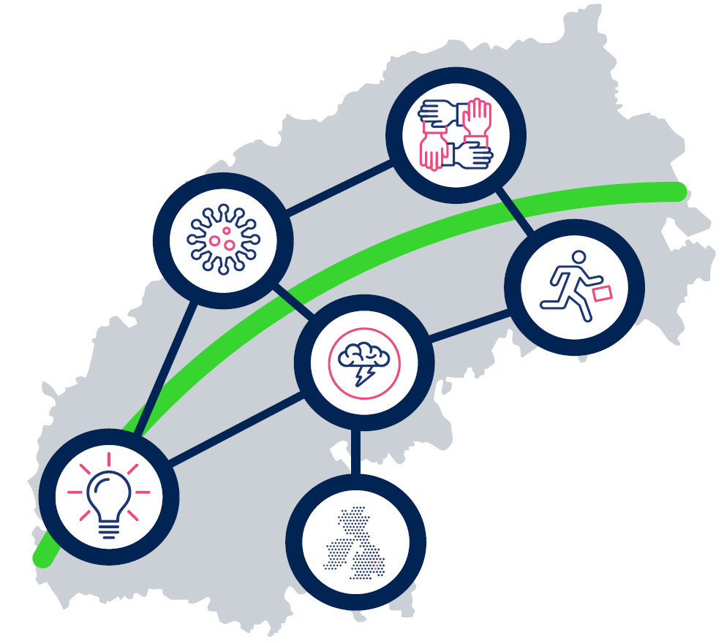
Why?
We continue to collaborate with Government on the establishment of an Oxford-Cambridge Arc Region to:
Support the UK economy
Legitimately seek to secure sustainable development
Raise productivity, reduce inequalities and reduce pressure on current and future populations
Ensure the Arc narrative does not have a singular obsession with housing – but rather thriving places
Develop clarity and certainty based on evidence and public engagement
Unlock significant funding – public and private - for infrastructure needed now and to support change
Move to a more stable and committed funding model
Oxford-Cambridge Arc

Slide 5
By 2050, the Arc will be the world leading place for high-value growth, innovation and productivity. A global hub where ideas and companies are generated and thrive, home to exemplary models of 21st century development, with a high-quality environment and outstanding quality of life, and with a strong economic focus that drives inclusive clean growth.
Economic vision
Notes:
It is clear that the key driver for the Arc is to deliver a strong economy – but leaders and chairs are clear the quality of our places and strength of our people is what will ensure higher and more sustained economic growth in future. With climate change recognised as our greatest collective threat, there is belief and evidence to suggest that if anywhere can tackle these grand challenges, it is the Arc with its track record for solid growth based on innovation and strong entrepreneurship.

Slide 6
Economic potential: double GVA to £200bn p.a.
Innovation-led growth to help solve major environmental, health and social challenges
To deliver green-growth and better quality opportunities for residents and businesses
>£4 investment return for every public £1
“The Oxford-Cambridge Arc is a global asset and national investment priority. With determined leadership and financial backing the Arc can leverage its innovation capability to drive regional growth, national prosperity and global inward investment into the UK.”
Economic prospectus: why we think the Arc is a national investment priority

Slide 7
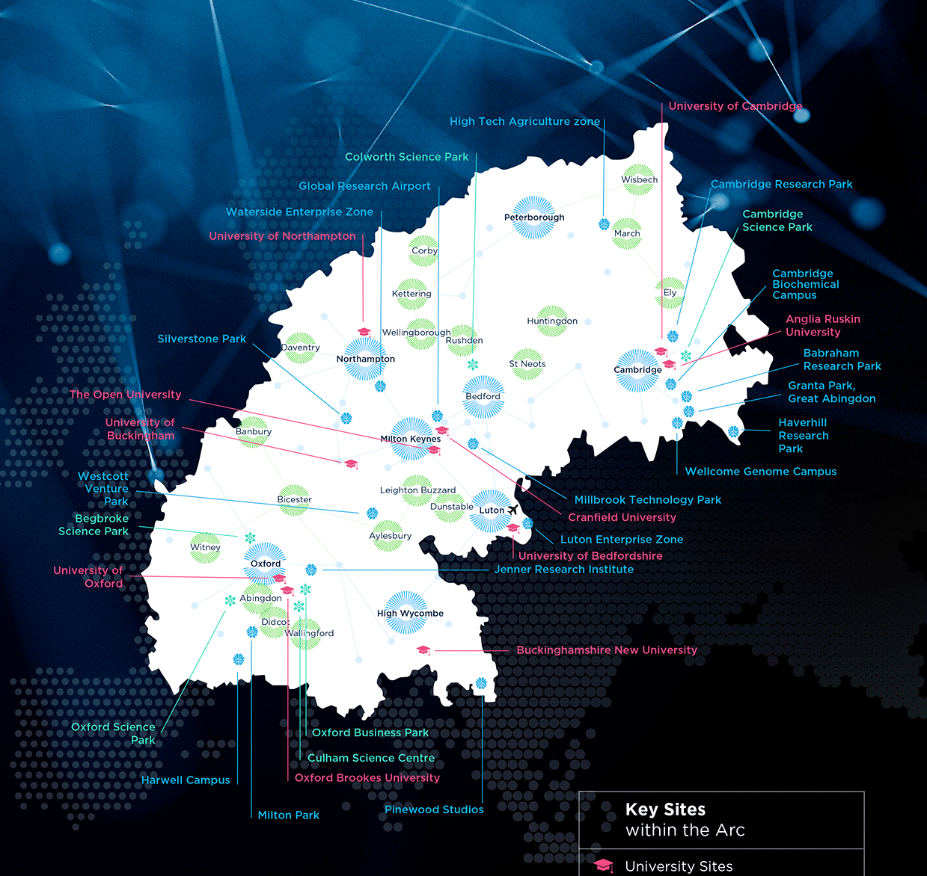

UK innovation region - creates significant economic value
Future
transport
Future
energy
Advanced manufacturing
Aviation
Life sciences
Space
Digital &
creative
Highest density of R&D institutions
Research, technology, testing capabilities and record in commercialising ideas, attracts new business and talent

Slide 8




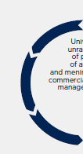




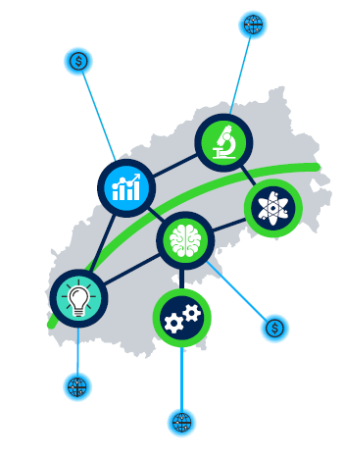

The Arc is home to world-leading innovation clusters. They provide the UK with an unrivalled concentration of assets and expertise.
Arc Life science clusters are built around nationally important assets such as the Rosalind Franklin Institute, Diamond Light Source, the Wellcome Genome Campus, Babraham Institute and the MRC Laboratory of Molecular Biology. Oxford University’s Jenner institute is at the heart of Coronavirus vaccine trials.
Arc expertise is critical to future green and connected mobility solutions. This area specialises in innovative technology, new fuels, engines and propulsion and low carbon engineering. Arc clusters are at the forefront of CAV technologies and testing. RACE at Culham Science Centre is a UK centre of Excellence.
Oxford and Cambridge have developed 9
unicorn businesses
(+$1bn value) and
a tech sector worth $57bn.
The Arc has a unique global research airport at Cranfield University, which is spearheading developments in the future of flight.
In the last 5 years, FDI in the Arc generated and protected over 26,000 jobs.
The space cluster at Harwell Campus, Oxfordshire is the largest in Europe and employs over 1000 people, in 110 organisations, and a burgeoning start-up community. The UK space sector has trebled in size in 10 years and remains a major growth area.
Motorsport valley, with Silverstone at its heart, is a £6bn cluster of over 4000 automotive, motorsport and advanced manufacturing companies.
Arc living labs will trial and commercialise new technologies including innovative connected and on-demand transport, smart homes and sustainable living.
The Arc aims to be carbon neutral by 2050.
Milton Keynes is a testbed for AI. The smart city has over 1000 people with machine learning skills. Is home to 6000 software engineers and 4000 data engineers.
Facts

Slide 9
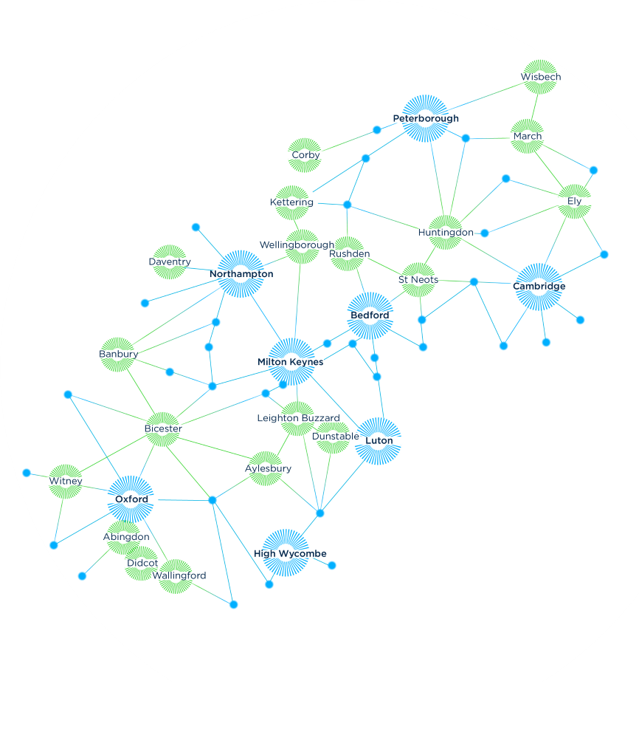
Current Arc Leadership Groups’ priorities
Arc Economic Prospectus
  pitch to CSR – recognition, investment, infrastructure
Arc Joint Economic Recovery Strategy
  Value-added to sub-regional and local strategies
The “Green Arc”
  Build on Local Natural Capital Plan work
Arc Spatial Framework
  Ensuring benefit for our existing and new communities
Arc Public Engagement
  with stakeholders and residents
Oxford-Cambridge Arc

Slide 10
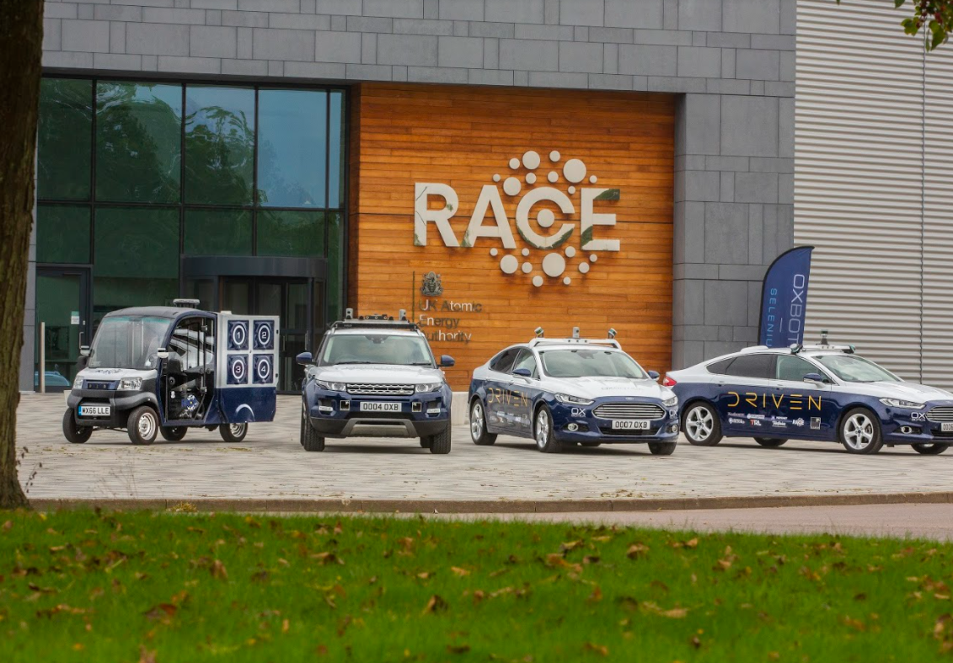
Strategic innovation infrastructure
Life science innovation network
Sustainable aviation
UK space gateway
Future mobility
Zero-carbon energy
Investment propositions

Slide 11
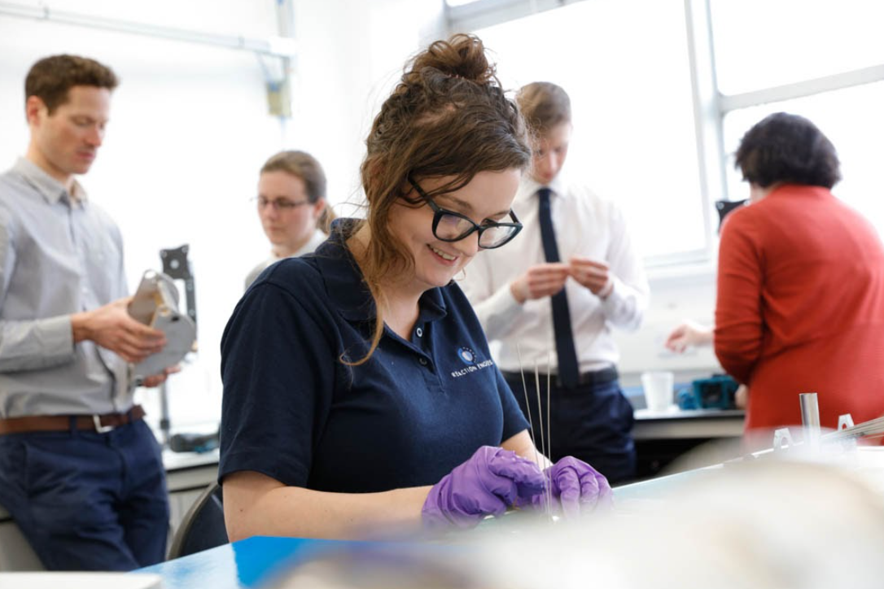
Enabling infrastructure
Business growth & commercialisation – support, investment and internationalisation
Skills – a responsive system, new STEM institutions and FE investment
Connectivity – digital, electric rail, road enhancements to reduce congestion, improve safety and air quality, support innovative and connected transport schemes
Places – aligned to sustainability principles, new, sustainable and affordable solutions for living, working and moving around
Environment– double the land for nature, enhancing our environment
Investment propositions

Slide 12
Arc Spatial Framework
Led and delivered by Government
Non statutory framework – national policy status?
Overarching ambition/ vision set out a clearly articulated, evidence-led, place-based but high level narrative
Focus on the three pillars of sustainability;
A ten year period (rolling) delivery plan set in a 30 year horizon
A robust performance monitoring framework, with a set of measurable and meaningful indicators and targets
Should take about 30 months to produce – led by Government open to collaboration
Arc Spatial Framework

Slide 13
Bev Hindle
Executive Director Arc Leadership Group
bev.hindle@oxfordshire.gov.uk

